Slide 1

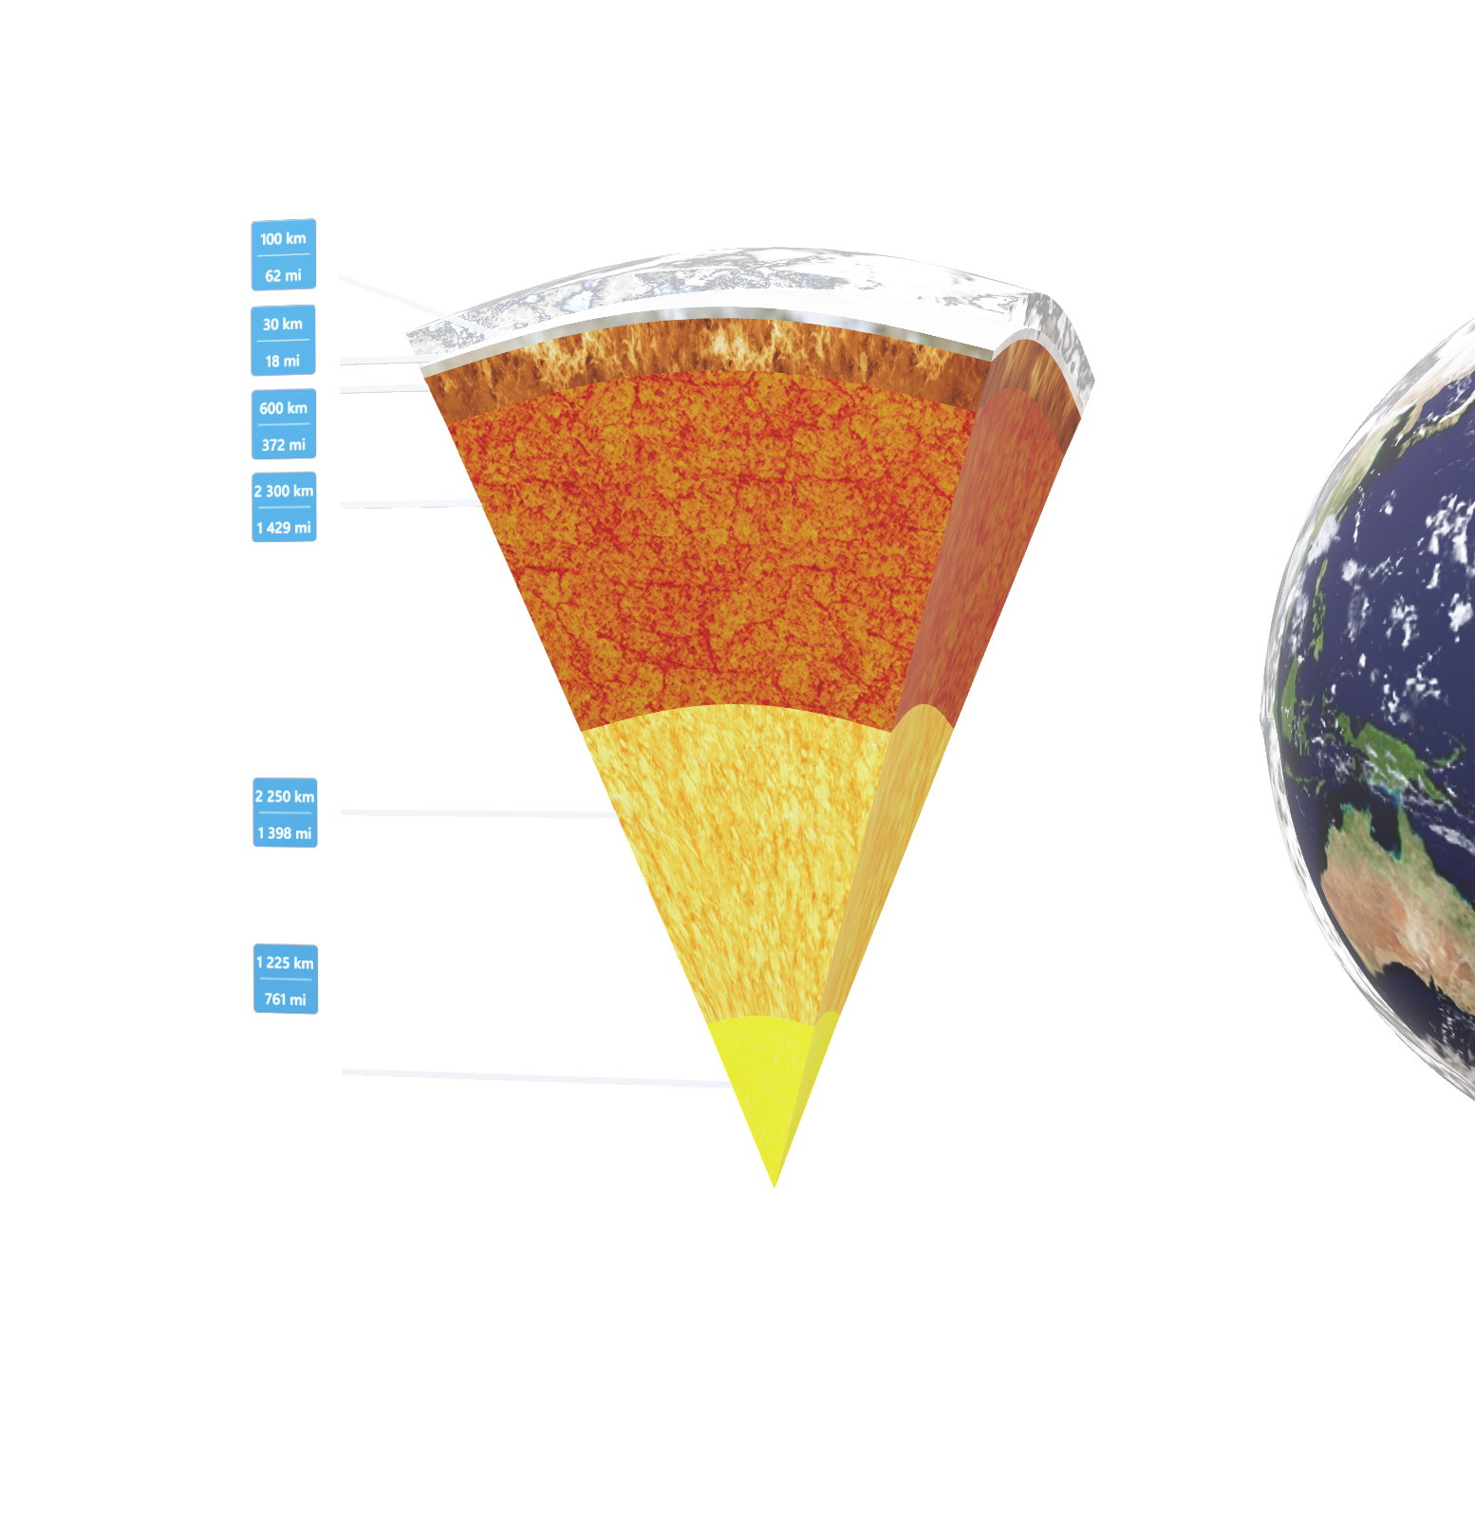
Duration: 95 min
High School
Grade: 9 -12
CCSS, NGSS
Info 6105
Team 6
Mubin Modi NUID: 002822945
Dhriti Kanchan NUID: 002794620
Earthquake Analysis and Prediction
Click on the model to interact

Slide 2
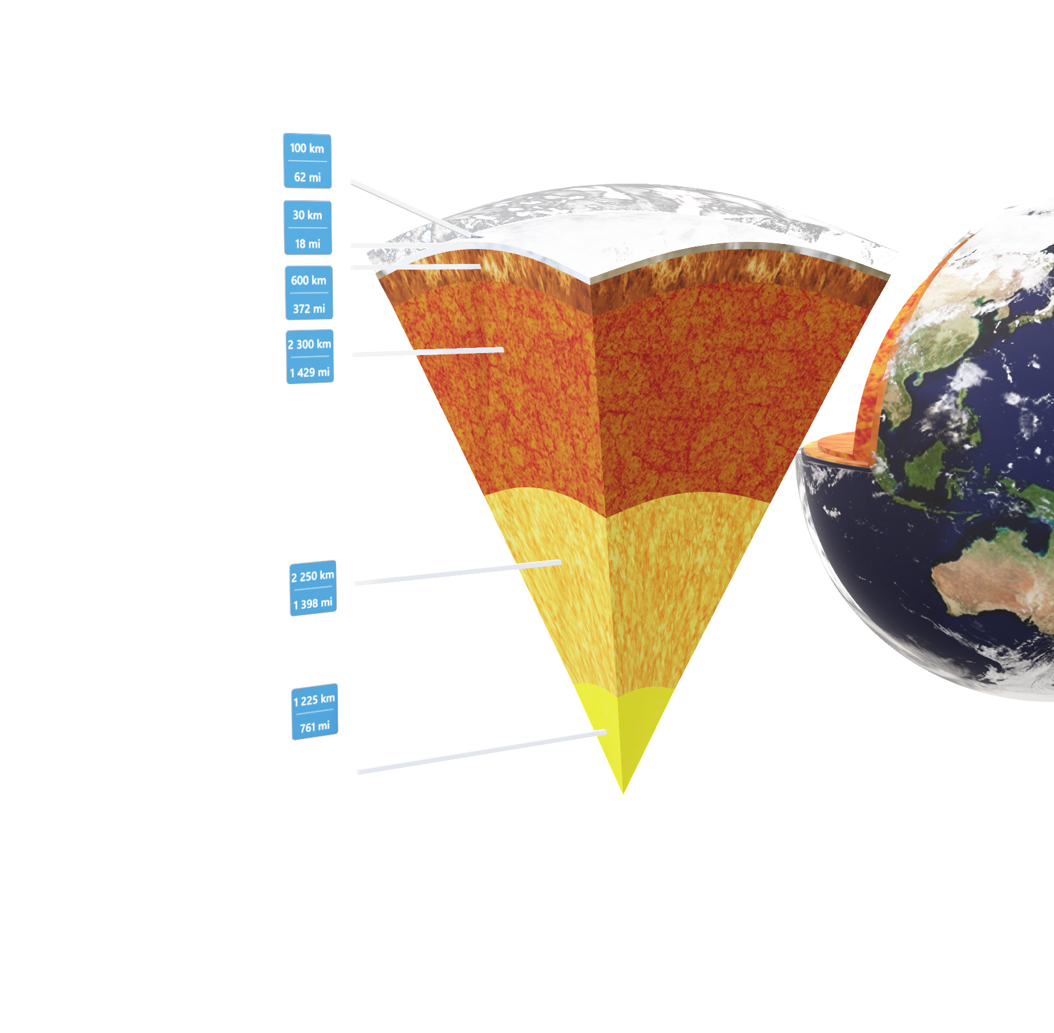
1. Why Earthquake Occur?
Tectonic Plates: Earthquakes are primarily caused by the movement of tectonic plates, which make up the Earth's crust.
Plate Boundaries:
Convergent Boundaries: Plates move toward each other, leading to subduction and intense pressure, causing earthquakes.
Divergent Boundaries: Plates move away from each other, creating tensional stress and fractures that result in earthquakes.
Transform Boundaries: Plates slide past each other horizontally, causing stress buildup and sudden release, resulting in earthquakes.
Release of Energy: The sudden release of accumulated stress in the Earth's crust generates seismic waves.
Epicenter: The point on the Earth's surface directly above the earthquake's origin is called the epicenter.
Seismic Waves: Energy from earthquakes travels in the form of seismic waves, which are detected by instruments like seismographs.
Other Causes: While tectonic activity is the main cause, earthquakes can also result from volcanic activity, human activities (mining, dams), and isostatic rebound (crust adjustment due to changing loads).
Click on the model to interact

Slide 3
Introduction
Earthquakes:
Sudden bursts of energy from the Earth's crust.
Can cause widespread damage and disrupt lives.
Predicting Earthquakes:
Traditionally reactive, focusing on post-event response.
Advancements in earthquake science and data analysis offer hope.
Background
Urgent need due to devastating consequences.
Aims to develop effective prediction models for earthquakes.
Motivation
.
Early warnings for evacuation and emergency protocols.
Resilient infrastructure through earthquake-resistant design.
Enhanced preparedness with accurate forecasts for effective response.
Goal

Slide 4
Description of the Dataset
1. Time: The timestamp of the earthquake event in milliseconds.
2. Place: Geographical location where the earthquake occurred.
3. Status: Represents the current state or condition of the event.
4. Tsunami: Boolean value indicating the presence of associated ocean waves.
5. Significance: Denotes the importance or impact level of the earthquake event.
6. Data_Type: Specifies the type of referenced data.
7. Magnitude: Measurement of the earthquake's size or intensity.
8. State: Represents the administrative division or state where the event occurred.
9. Longitude: Coordinates of the earthquake's location.
10. Latitude: Coordinates the earthquake's location.
11. Depth: The depth of the earthquake's epicenter.
12. Date: Date when the earthquake occurred.
Data Source https://www.kaggle.com/datasets/alessandrolobello/the-ultimate-earthquake-dataset-from-1990-2023/data
https://github.com/fraxen/tectonicplates

Slide 5
Methodology
Data Loading:
Loaded the dataset for earthquake data examination.
Initial Inspection:
Examined column names and data types for structure understanding.
Duplicate Detection:
Scrutinized for duplicate entries to maintain data integrity.
Date Column Conversion:
Converted date column to datetime for temporal analysis.
Unique Values Verification:
Checked each column for unique values, gaining insights into data diversity.
Accuracy Check:
Reevaluated values, especially from new features, ensuring dataset accuracy.
Column Cleansing:
Cleansed 'status' and 'data type' columns for consistency, removing unnecessary values.

Slide 6
Exploratory data analysis and Feature engineering
- **Feature Engineering:**
- Boosted model clarity and accuracy with strategic feature crafting.
- **Label Encoding:**
- Used encoder for numerical conversion of categorical data.
- **Date Column Enhancement:**
- Extracted columns for deeper dataset analysis.
- **Profile Report:**
- Conducted thorough exploration of dataset characteristics.
- **Visual Exploration:**
- Plotted graphs for insights into variable relationships.
- **Geographical Context:**
- Incorporated external data for tectonic plate boundaries.
- **Encoding Techniques:**
- Employed label encoding for numerical transformation.
- **Correlation Analysis:**
- Calculated metrics, focusing on magnitude variable relationships.
USGS, Map plate tectonics world, marked as public domain, more details on Wikimedia Commons

Slide 7
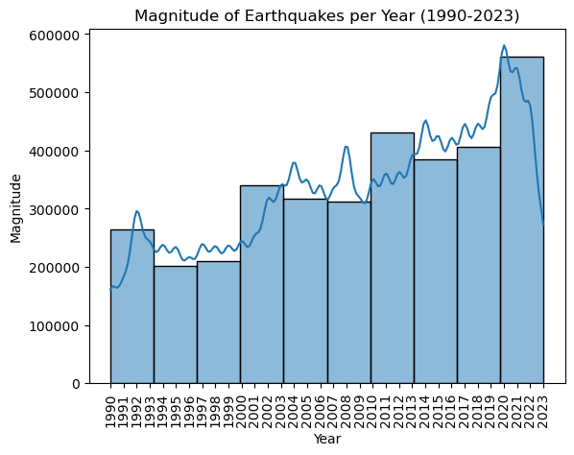
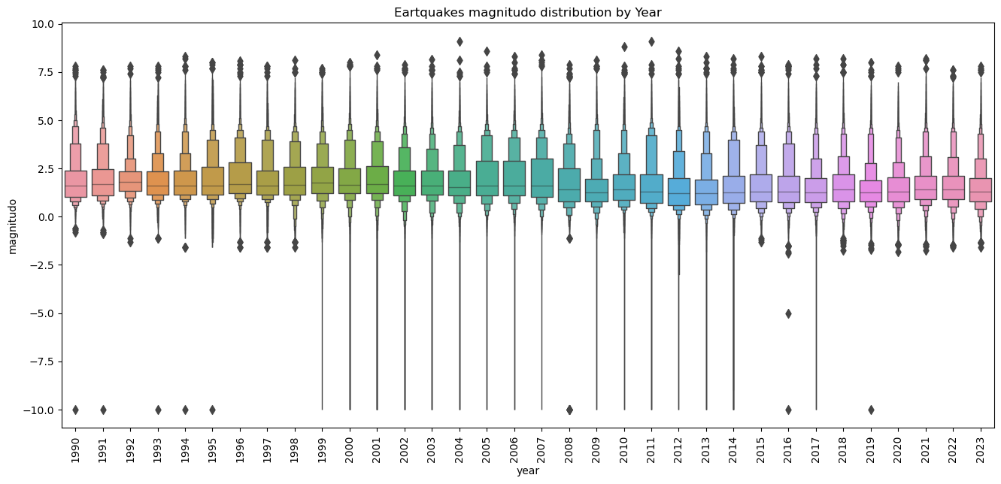

Slide 8
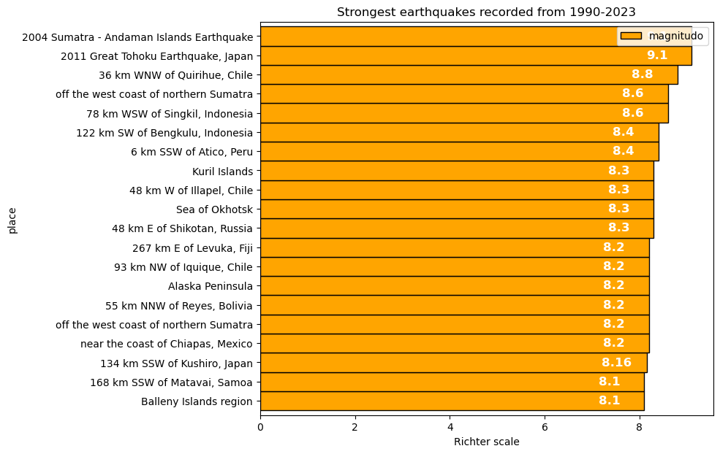
Timeframe: 1990 to 2023 - Focus on powerful earthquakes.
Measurement Scale: Richter Scale - Numerical representation of seismic strength.
Significance: Highlights exceptionally strong earthquakes for valuable insights.
Purpose: Understand seismic activity intensity and potential implications.

Slide 9
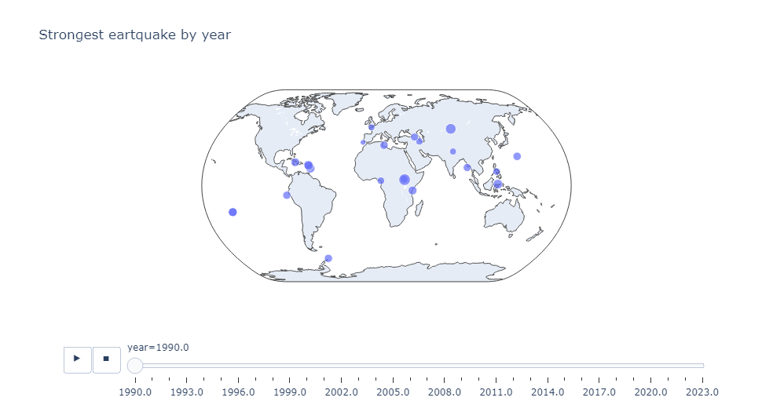
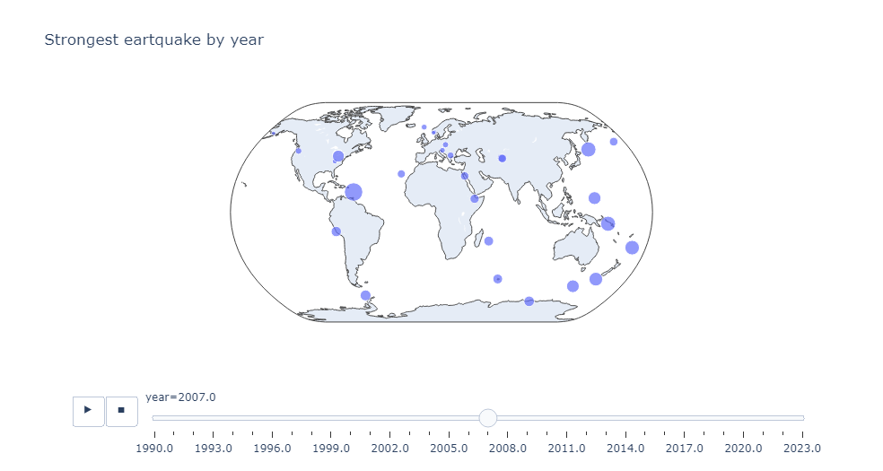
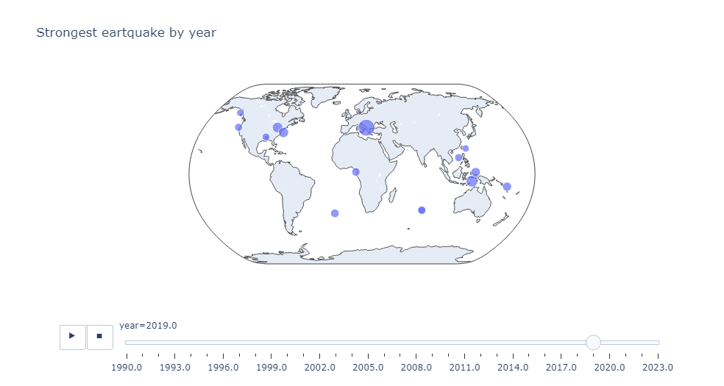

Slide 10
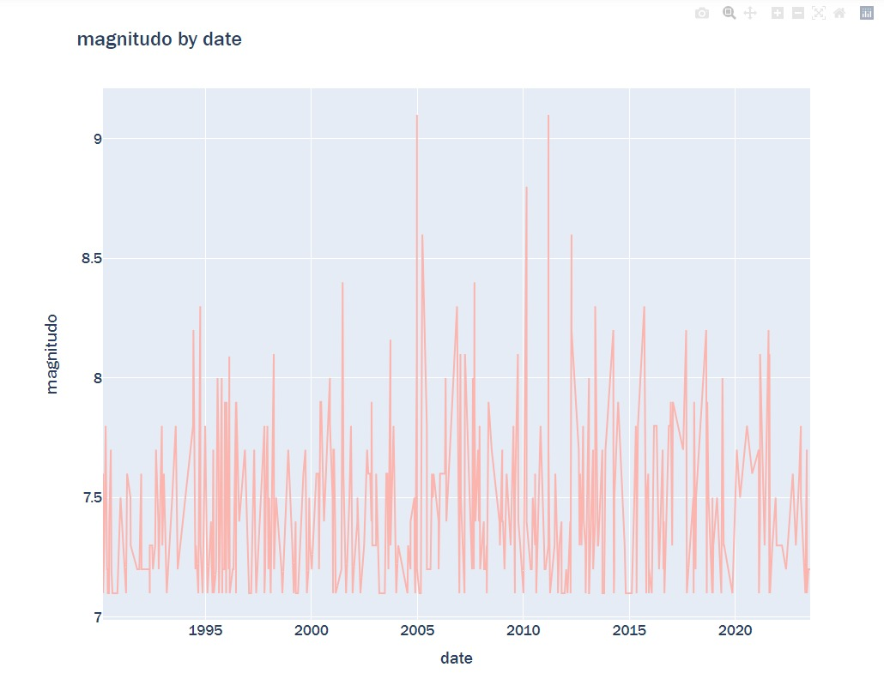
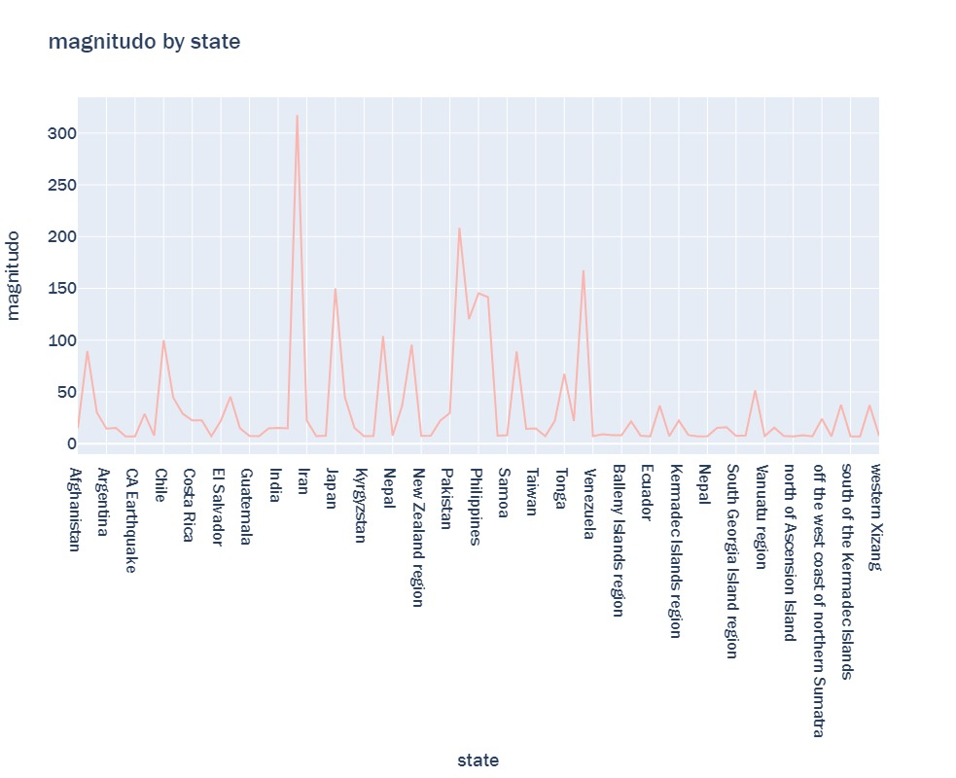

Slide 11
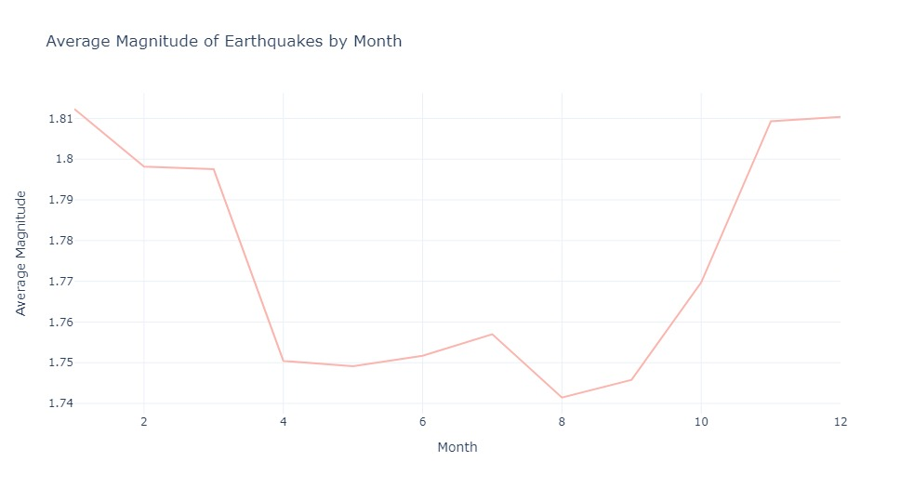
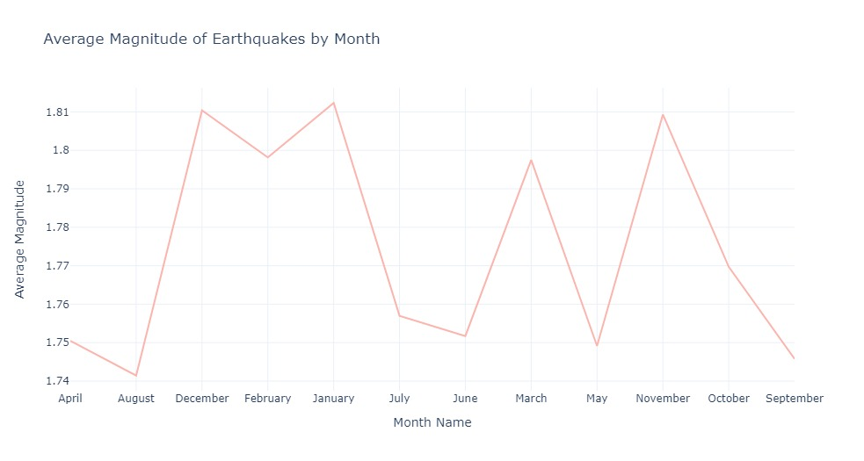
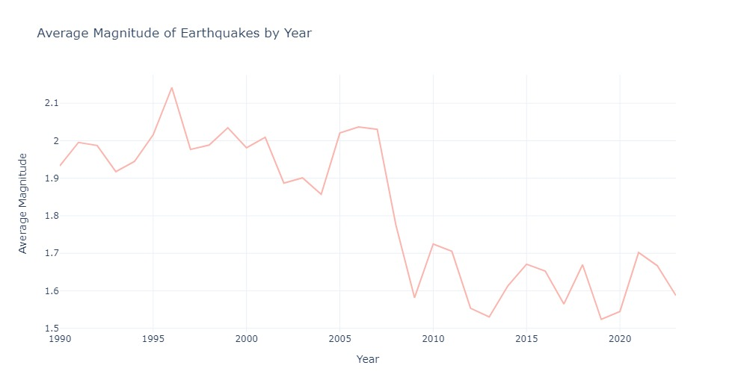
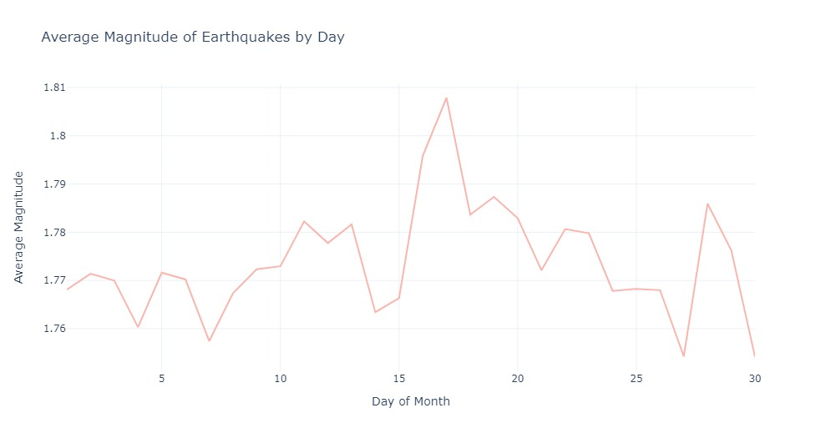

Slide 12
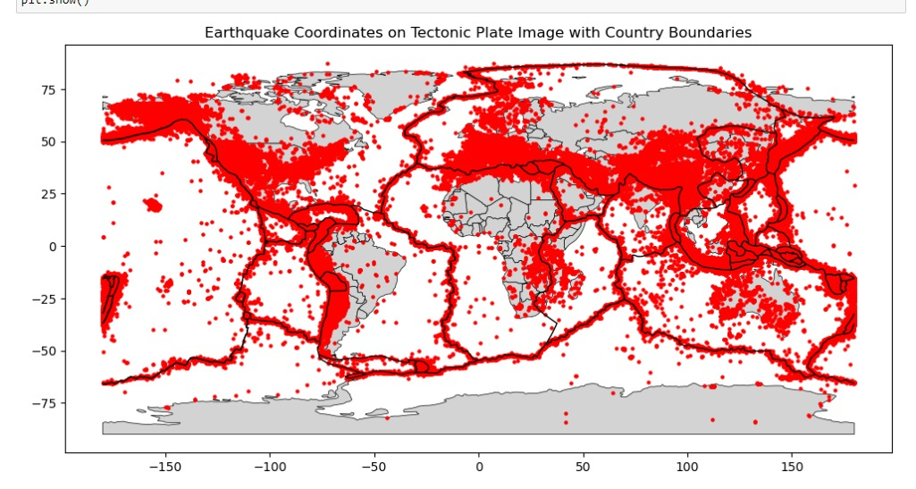

Slide 13
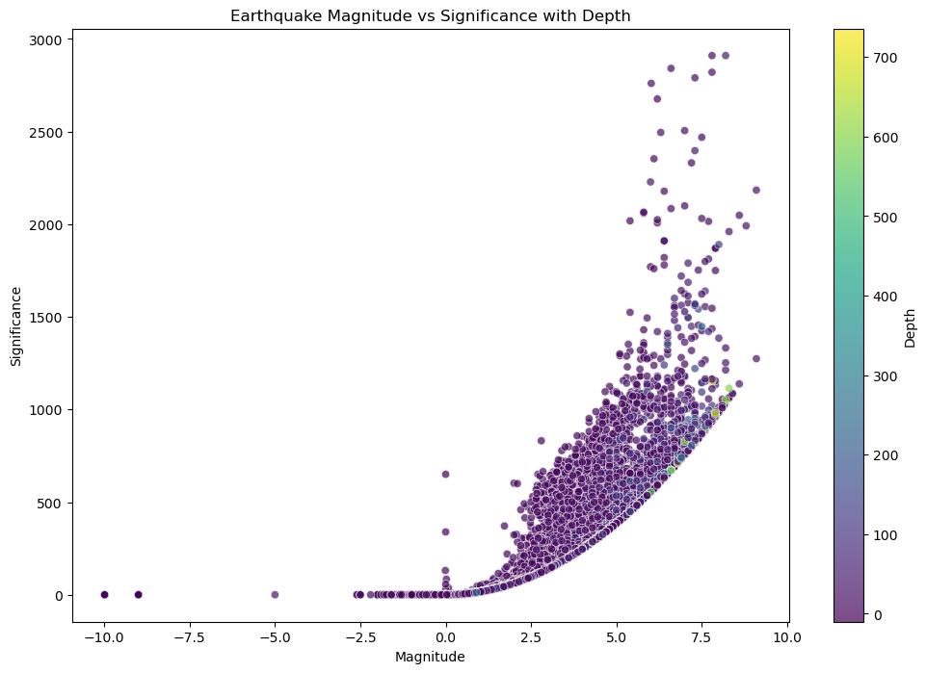

Slide 14
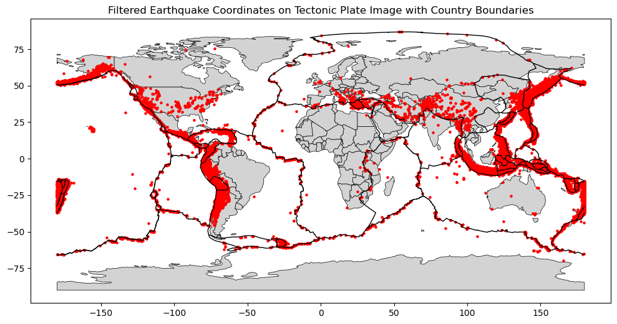
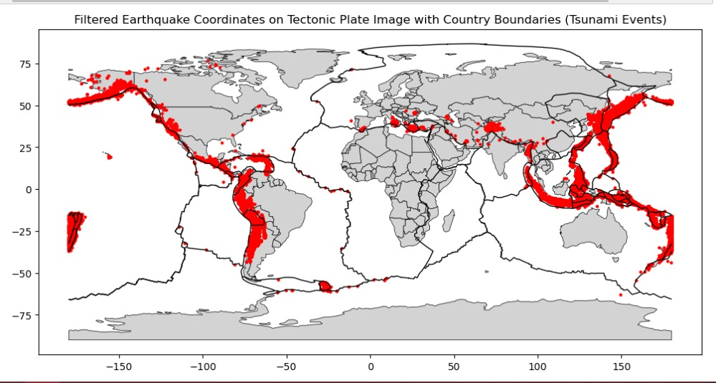

Slide 15
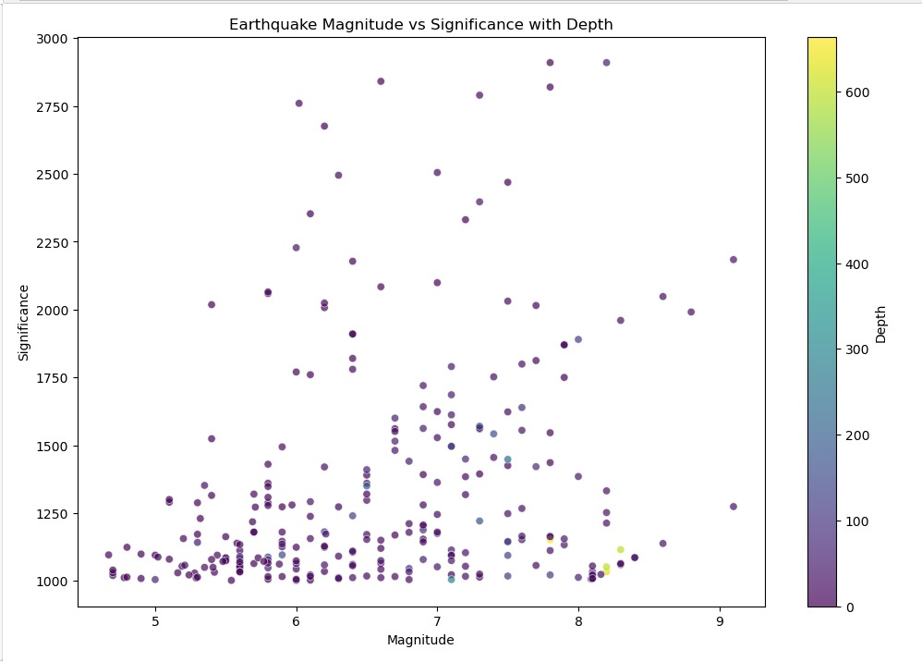
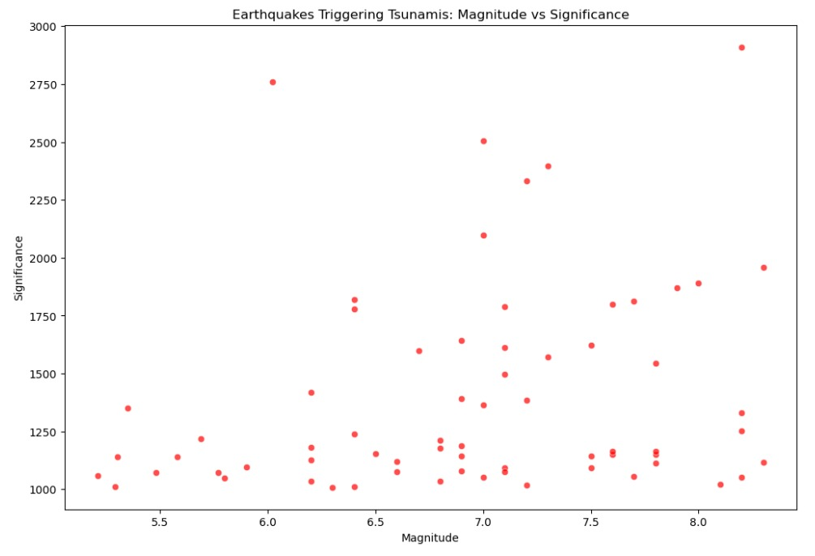

Slide 16
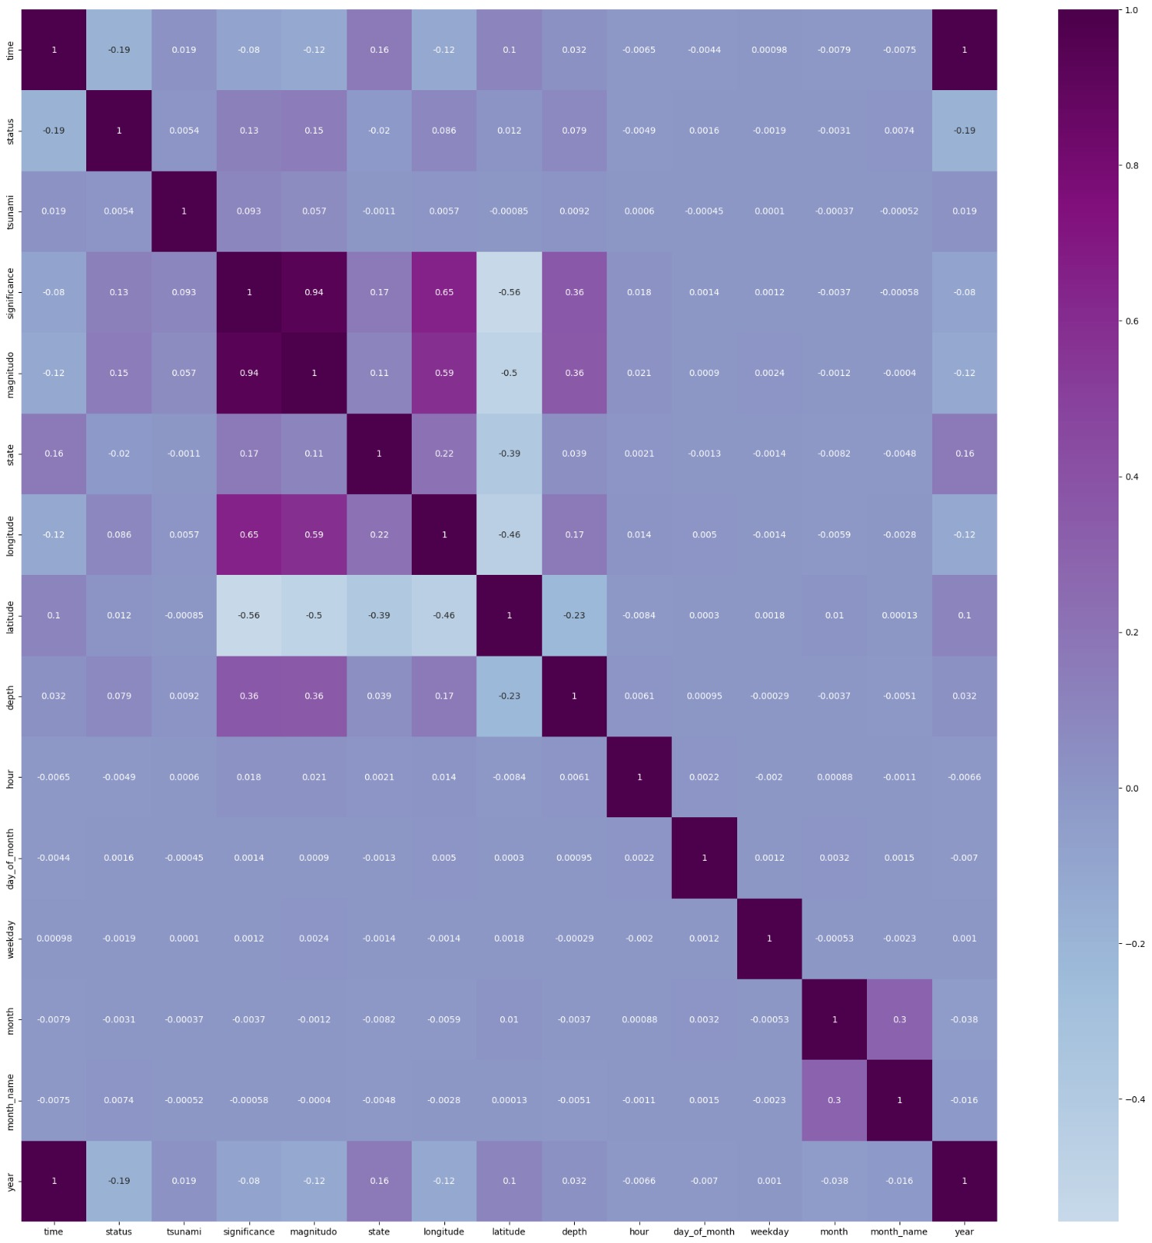
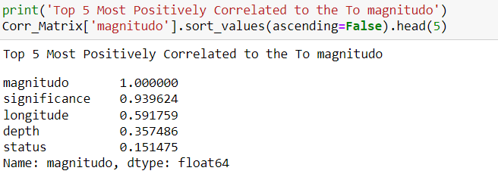
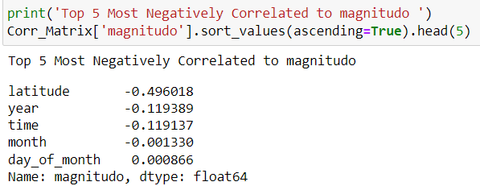

Slide 17
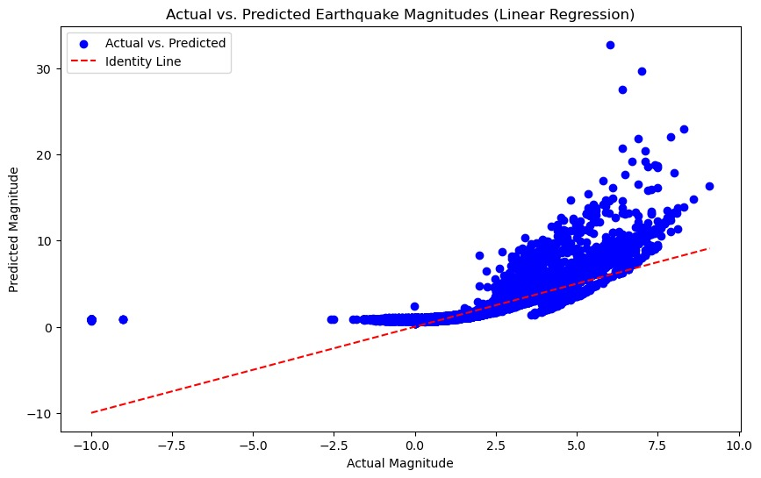
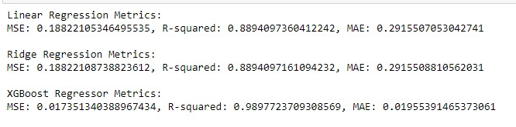
Model Selection and Evaluation:
Linear Regression:
Statistical method for modeling the relationship between dependent and independent variables.
Step 1: Used train_test_split (70% train size, random state 70).
Step 2: Determined test accuracy with y_test and X_test predictions.
Step 3: Hyperparameter tuning with gridsearchCV.

Slide 18

Model Selection and Evaluation:
Ridge Regression:
Adds a penalty term to linear regression to prevent overfitting.
Step 1: Used train_test_split (70% train size, random state 70).
Step 2: Determined test accuracy with y_test and X_test predictions.
Step 3: Hyperparameter tuning with gridsearchCV.

Slide 19
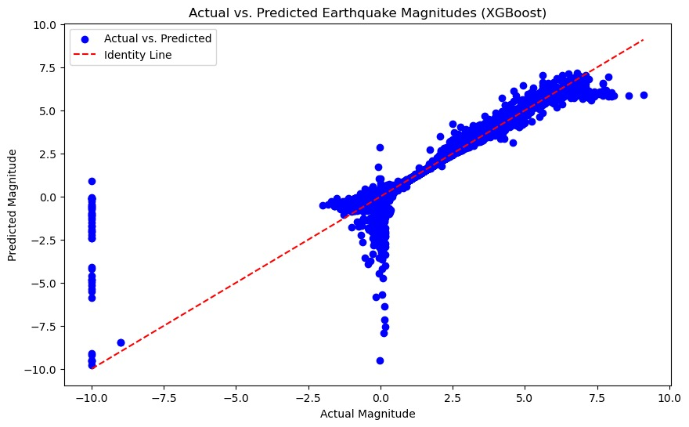
Model Selection and Evaluation:
XGBoost Regressor:
Machine learning algorithm for numeric outcome prediction.
Step 1: Random 40% sample of the dataset.
Step 2: Used train_test_split (80% train size, random state 42).
Step 3: Hyperparameter tuning with gridsearchCV.

Slide 20
Conclusion
Plate Boundaries and Tension:
Majority of earthquakes and tsunamis near tectonic plate boundaries due to plate tension.
Identifying High-Impact Areas:
Allows confident identification of high-impact areas, emphasizing the need for resistant structures.
Predictive Model Success:
Successfully forecasted earthquake magnitudes using Linear Regression, Ridge Regression, and XGBoost Regressor.
Performance Metrics:
Linear and Ridge Regression: MSE 0.1882, R-squared 0.2916, MAE.
XGBoost Regressor: MSE 0.0174, R-squared 0.9898, MAE 0.0196.
Overfitting Caution:
Potential overfitting in XGBoost model, likely due to small dataset size.
Conclusion - Project Impact:
Explored earthquake data comprehensively for geological understanding.
Unraveled complexities, identified key factors influencing occurrence and intensity.
Essential for preventive measures, prioritizing earthquake-resistant structures in vulnerable

Slide 21

Thankyou

